Slide 1

RCB IPL Mega Auction Strategy
by A. Raja Vishwanath
(30/01/2026)

Slide 2
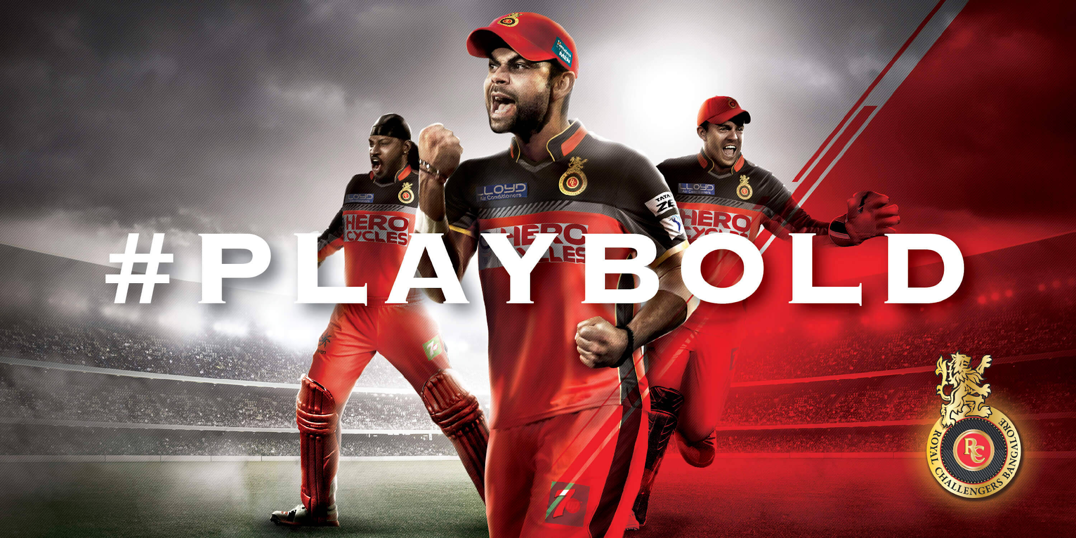
About RCB
Royal Challengers Bangalore (RCB) was established in 2008 as one of the original eight franchises in the Indian Premier League (IPL)
RCB was known for its star-studded line-ups but inconsistent results, finishing as IPL runners-up three times (2009, 2011, and 2016) and often missing the playoffs in other seasons despite its popularity and big-name acquisition

Slide 3
Analysis objective
To develop an auction strategy to bag the best players for IPL Season 2017.
Suggesting the players who will be the best fit for the team and can help RCB in winning the championship trophy.
Analyzing the performances of present and past players of RCB team and as well as other players to find the players who are more consistent.
Analyzing the team’s weaknesses and strengths to finalize the players who can best fit in to the team.
Formed an auction strategy for bagging the best players for RCB team who will help in winning championship.

Slide 4
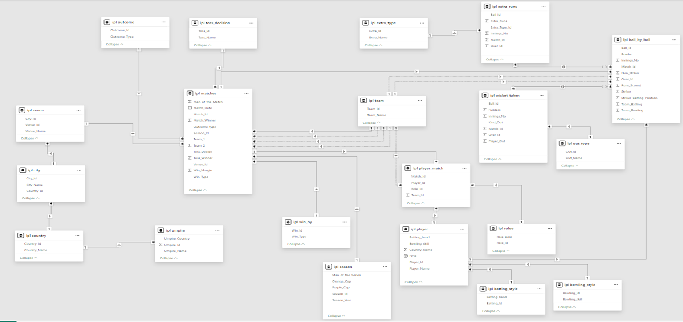
Database Schema

Slide 5
IPL Dataset Overview
Ball by Ball : Stores delivery-level data for every ball in a match.
Batting style : player batting techniques such as right or left-handed.
Bowling style : Defines player bowling type and style.
City : Stores city information where venues are located.
Country : Stores country details for players, teams, and venues.
Extra Runs : Records extra runs conceded on specific deliveries.
Extra Type : Defines types of extras like wide, no-ball, bye.
Matches : Stores match-level details including teams, venue, and results.
Out_Type : Defines modes of dismissal such as caught or bowled.
Outcome : Stores a general match possible outcome information.

Slide 6
IPL Dataset Overview
Player : Contains player personal and identification details.
Player Match : Maps players to matches they participated in.
Rolee : Defines player roles such as batsman, bowler or all-rounder.
Season : Stores IPL season details and identifiers.
Team : Stores IPL team information and identifiers.
Toss Decision : Defines toss decision options like bat or field.
Umpire : Stores umpire details for matches.
Venue : Stores stadium and venue-related information.
Wicket_taken : Records wicket events at ball level.
Win_By : Defines victory type such as runs or wickets.

Slide 7
Methodology
Data Cleaning: Thoroughly checked the entire dataset for any inaccuracies, but the data is clean.
Data Aggregation: Used various aggregation functions such as count(), sum(), avg(), etc. to aggregate the data and get the meaningful summary.
Data Manipulation: Created few views by using using joins, and also used sub-queries for easier analysis.
Data Measurement: Measured the data of various players by using aggregation functions and other functions like limit, window rank functions, etc.
Data Visualization: Used Google Sheets for visualization of outputs to summarize the data, gain meaningful insights, and identify any trends.

Slide 8
Overall Player Stats

Slide 9
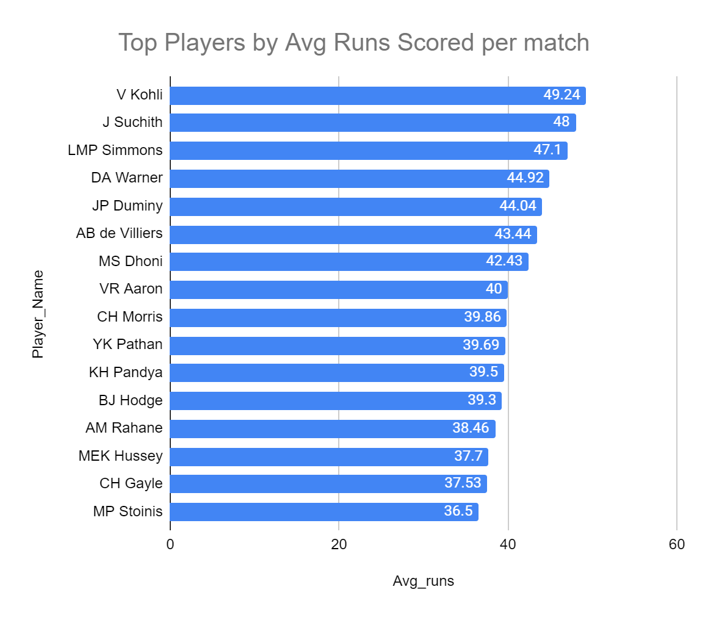
Top Batsman by Average Runs per match
We can see that Virat Kohli has the highest average runs per match 49.24, when considering all the seasons.
We can also see that other RCB Players like AB de Villiers and Chris Gayle are also in the list

Slide 10
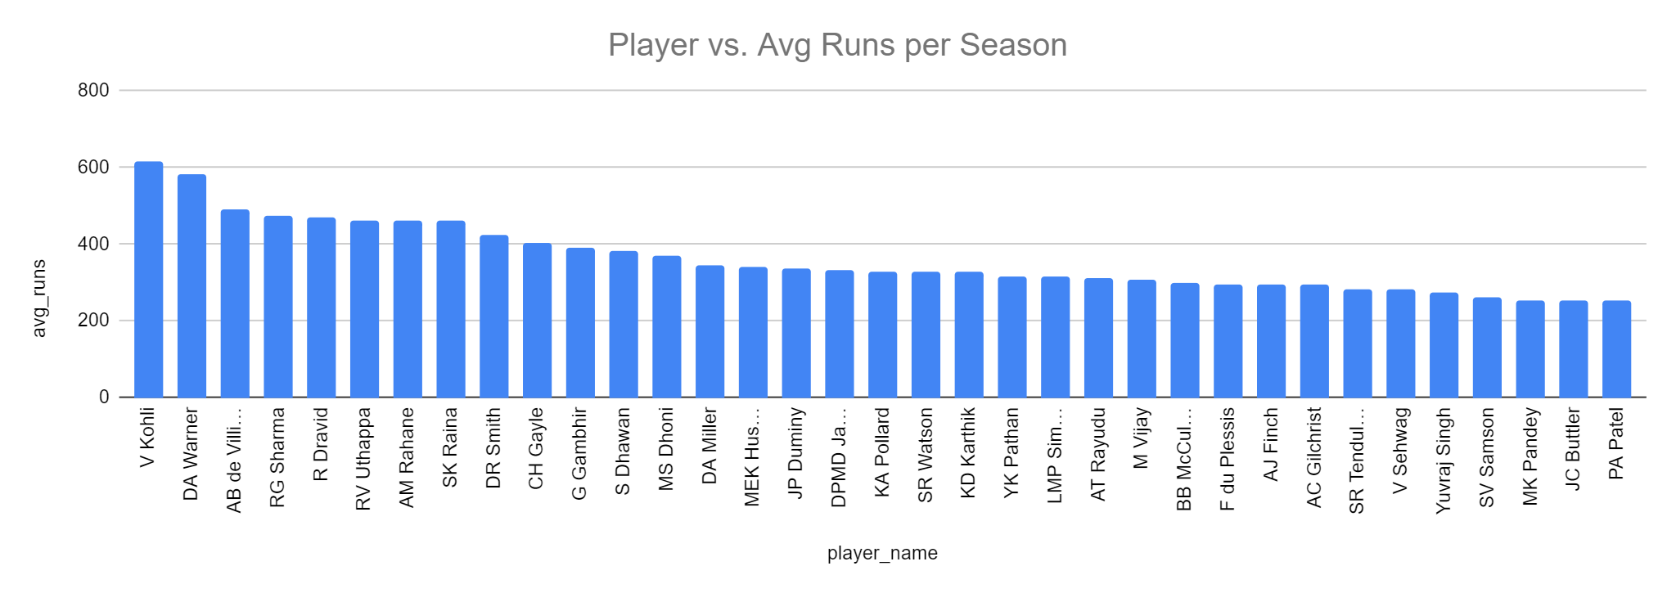
Top Batsman by Average Runs per Season
Virat Kohli (615.5) again tops the list. David Warner (584) is second and another RCB batsman
AB de Villiers (488.75) is third, Chris Gayle(403.5) is in 10th place. There are 3 RCBians in top 10.

Slide 11
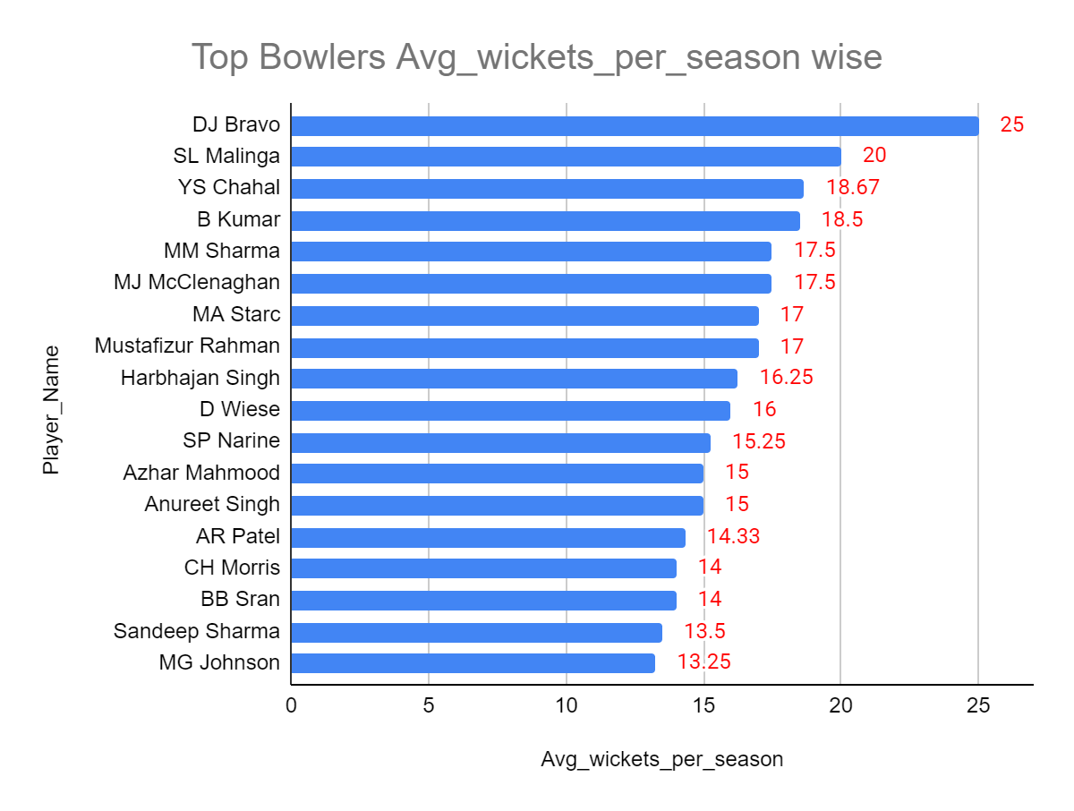
Top Bowlers as per avg wickets per season
CSK Bowler DJ Bravo tops the list with 25 average wickets per season.
Malinga with 20 and Yuzvendra Chahal with 18.67
List also features top Indian Bowlers like Bhuvneshwar Kumar, Harbhajan Singh and Sunil Narine.

Slide 12
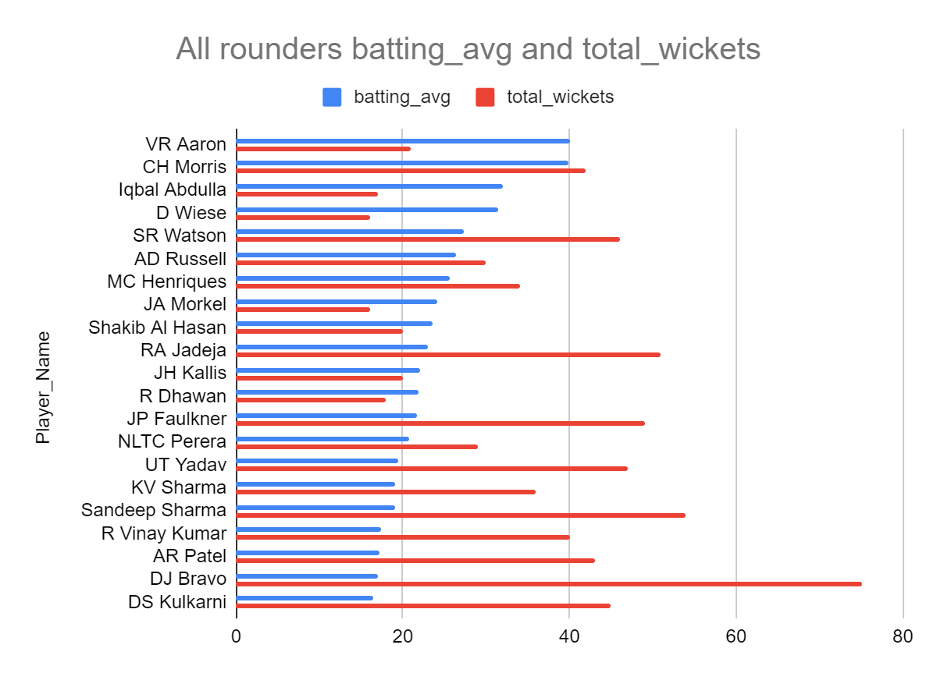
Top All Arounders of all seasons
To consider a player as all-rounder we have considered batting average of all seasons and total_wickets in all seasons.
Chris Morris, SR Watson, AD Russell, Henriques, RA Jadeja etc are great allrounders

Slide 13
Toss & Innings Impact

Slide 14
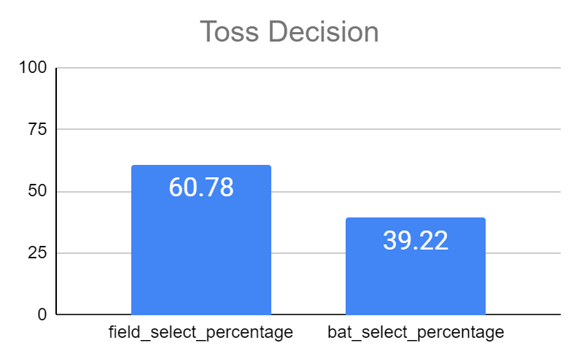
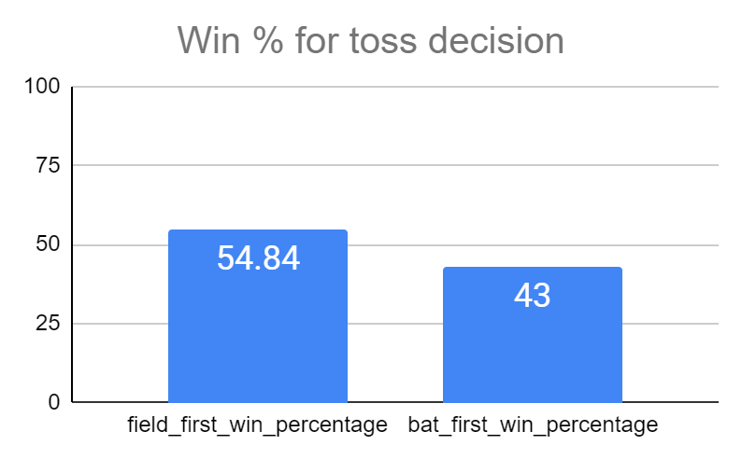
Toss and its Outcome
In a toss, Teams prefer fielding first with 60.78% opting for it
And it is also backed by match outcome that fielding first has win percentage of 54.48% compared to bat first which has win percentage of 43% only

Slide 15
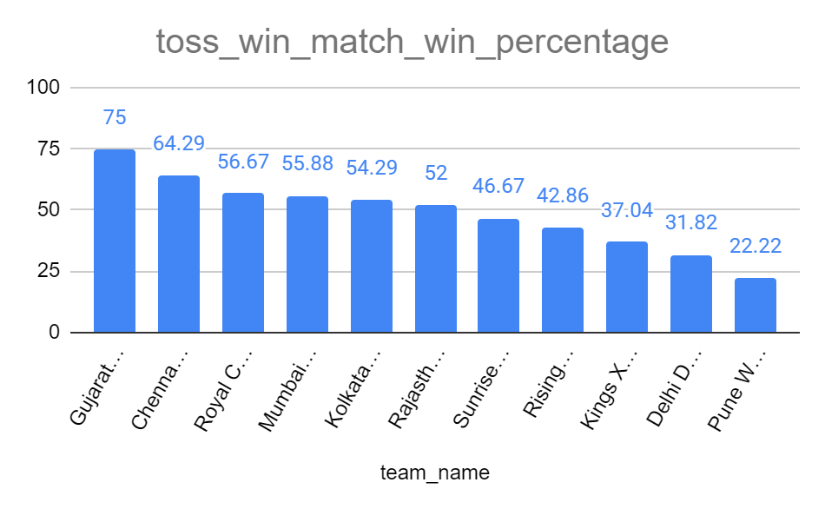
Win Percentages for different teams
Gujarat Lions has highest toss_win_match_win percentage with winning 75% of the matches where the win the toss
Second is Chennai Super Kings with 64.29%
Third is RCB with 56.67%

Slide 16
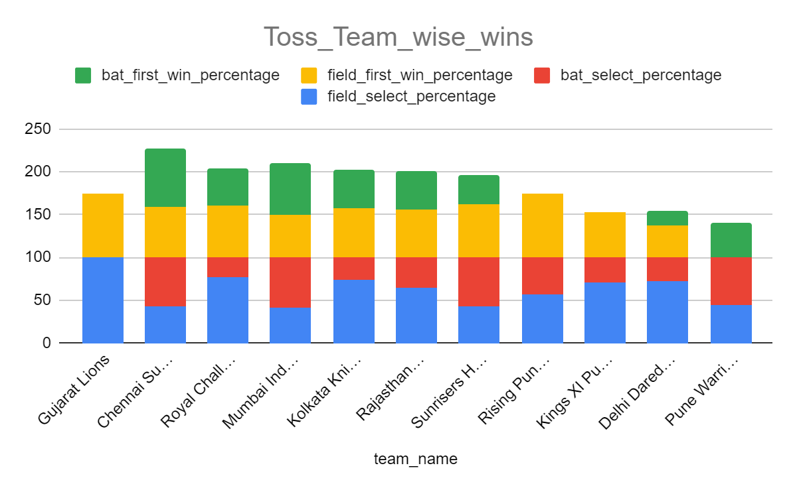
Toss Choice and Match Outcomes
The preference to bat or field first varies from team to team.
RCB’s first choice is fielding (76.67%) and corresponding win percentage is 60.87%
RCB’s second choice is bat (23.33%) and corresponding win percentage is 42.86%

Slide 17
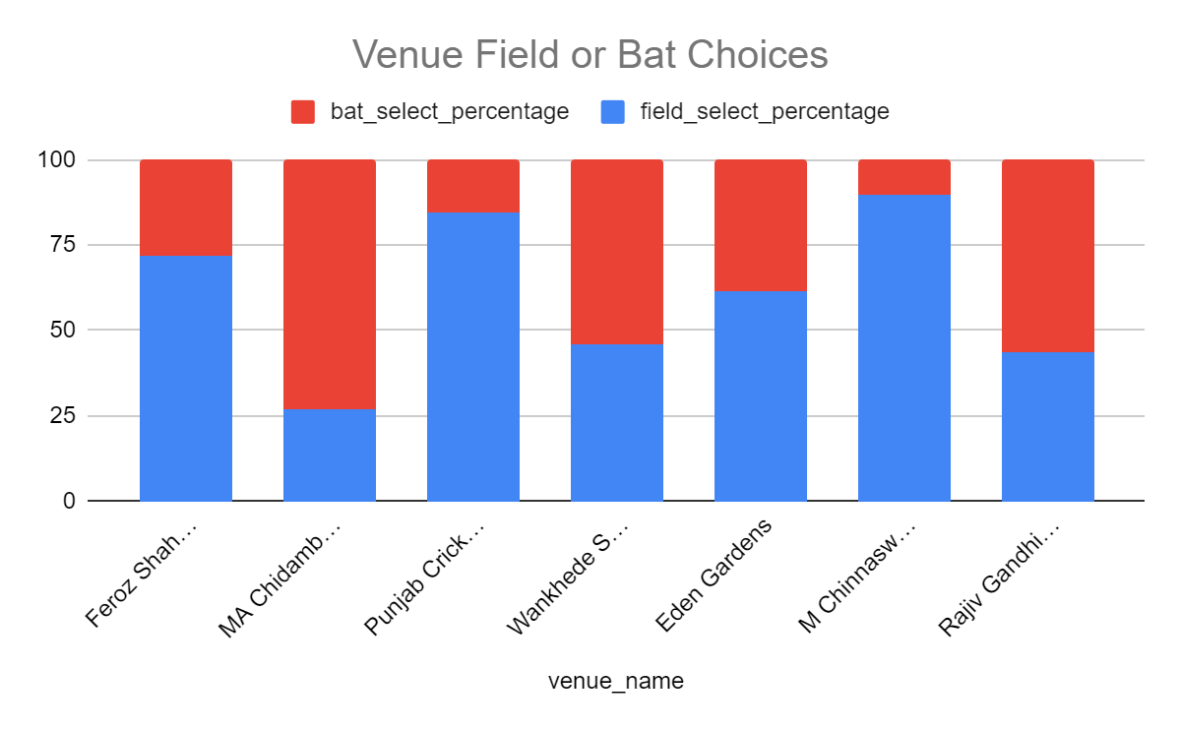
Toss choices based on Venue
We can see each stadium has a noticeable preference to bat first or field first.
RCB’s home ground M Chinnaswamy Stadium has a field first preference.
However it has to be noted that rcb plays half of the matches played here

Slide 18
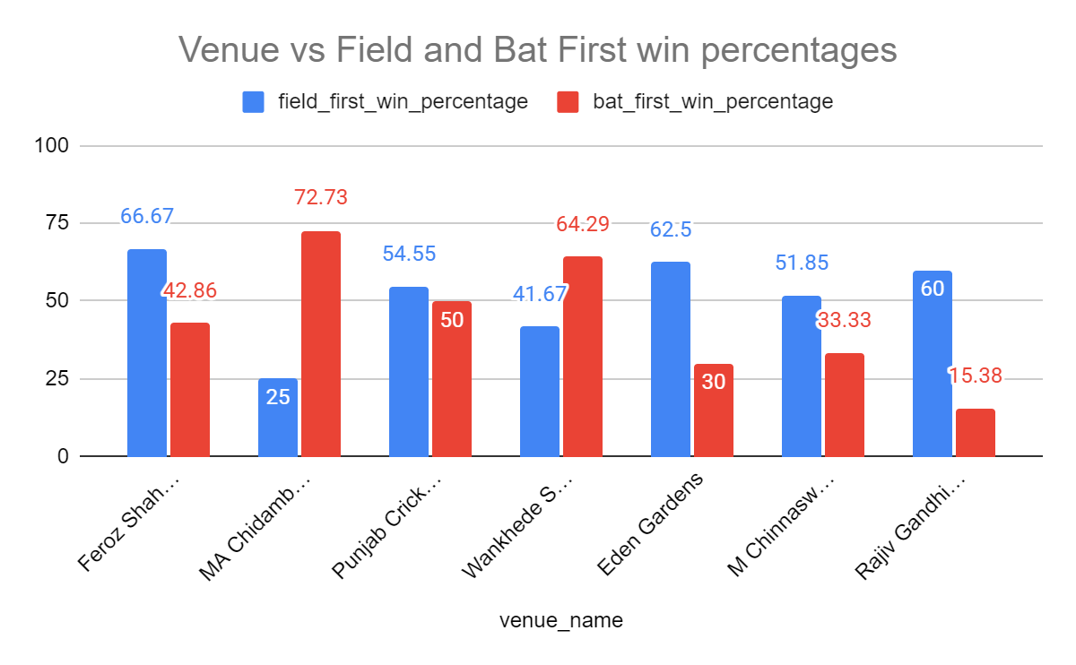
Win and Loss stats chosen bat and field
Resonating with the toss choice preferences specific to venues, the result of matches follow.
Chinnaswamy Stadium has 51.85% chance of winning when field first and 33.33% chance of winning when chosen bat first.

Slide 19
Viewership and Fanbase Factors

Slide 20
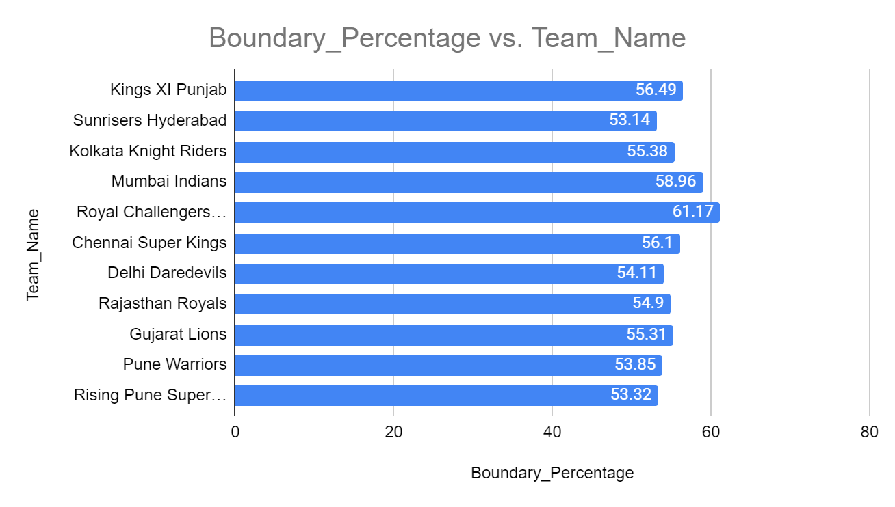
Boundaries stats of each Team
The chart shows what is the percentage of boundaries in the total runs scored.
RCB has the highest percentage of Boundaries with 61.17% runs coming from boundaries.
Almost all teams are doing well with boundaries.

Slide 21
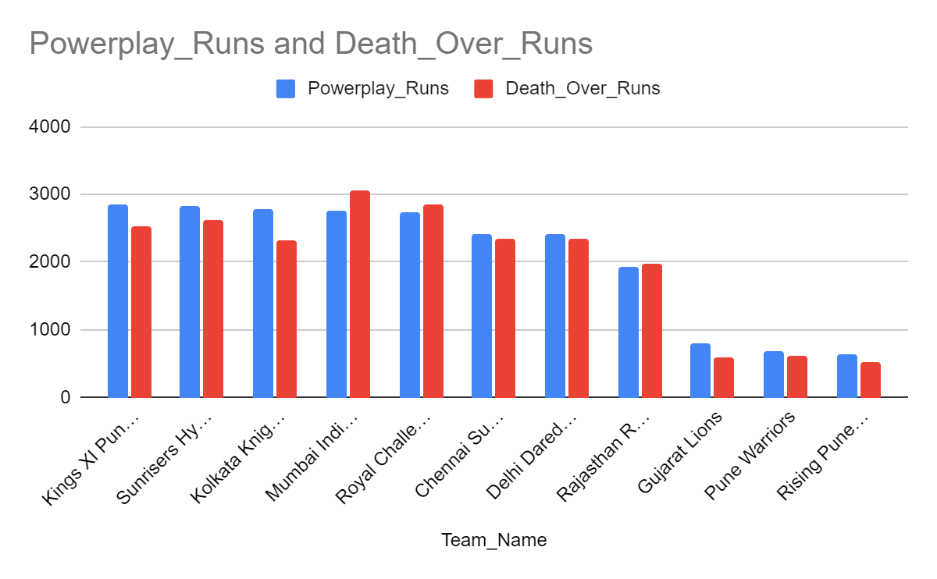
Powerplay & Death_Over Performances
Mumbai Indians has the highest Death Overs runs, matching its strong batting line up.
RCB even though the batting line up isn’t deep, due to consistent performances from top order batsmen like Kohli, ABD and Gayle is on par with all other teams.
GL,PW,RP are newer teams hence small totals.

Slide 22
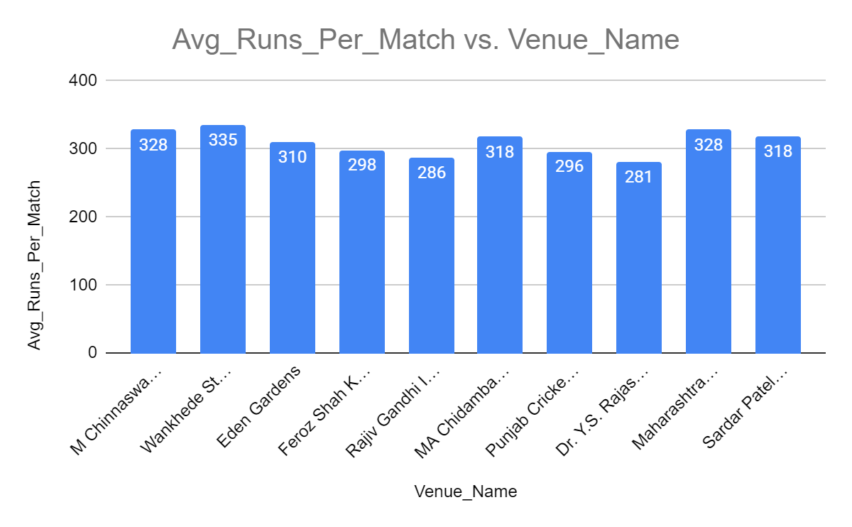
Avg Total Runs scored per match in venue
Higher run count means higher satisfaction rates and viewership.
Wankhede has the highest Average runs per match with 335 runs.
RCB homeground Chinnaswamy stadium is second with 328 runs, tied with Maharastra Stadium.

Slide 23
Home ground Advantage

Slide 24
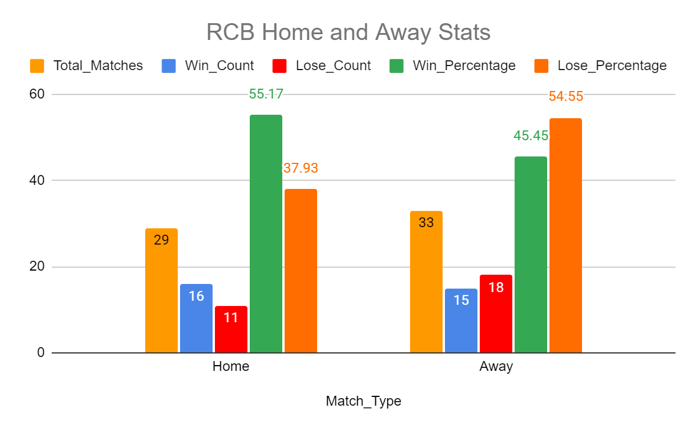
Wins and Loses
Out of 29 Matches RCB Played in Home ground, it won 16 of them (55.17%)
Out of 33 Matches RCB Played in other stadiums it has won only 15 of them (45.45%)
It shows RCB can take advantage of home ground to qualify for playoffs, but the play_off matches
When organized outside Home, RCB loses this advantage and is one of reason it hasn’t won a trophy.

Slide 25
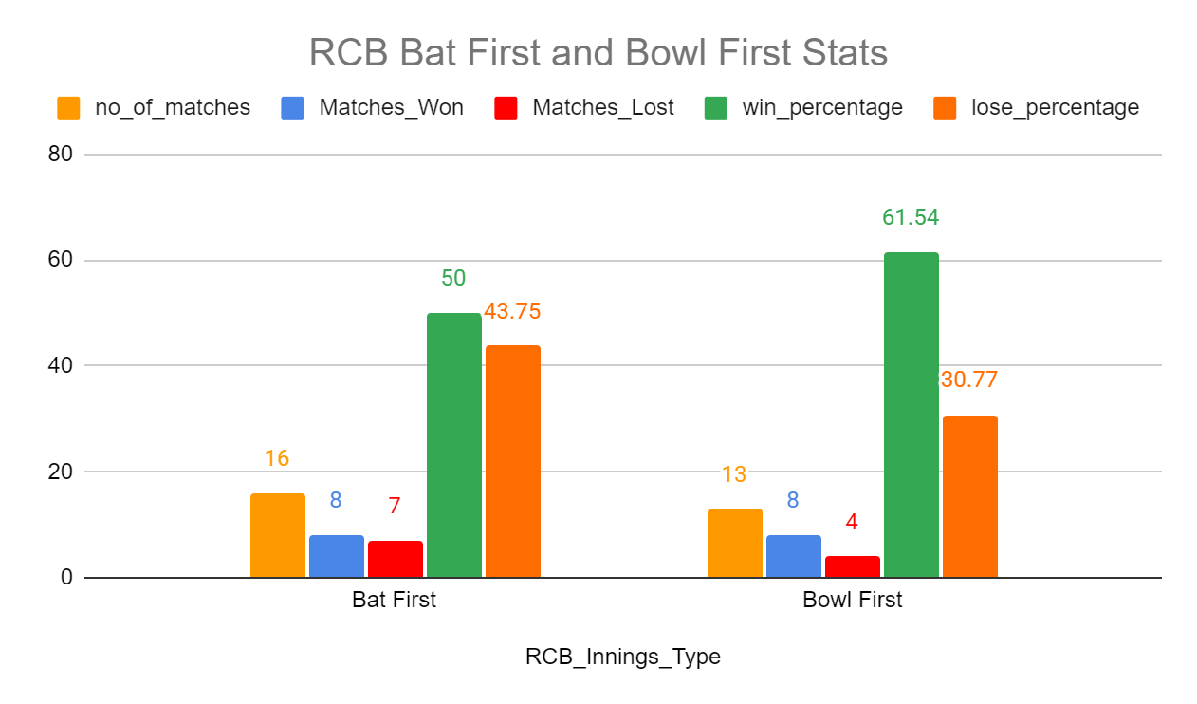
RCB Innings Stats At Home (Chinnaswamy)
Of the 29 matches it played at home, In 16 Matches it batted first and won 50% of those matches.
In 13 Matches it bowled first and won 61.54% of the matches successfully chasing the target. (A reason why RCB keeps on choosing field first.)

Slide 26
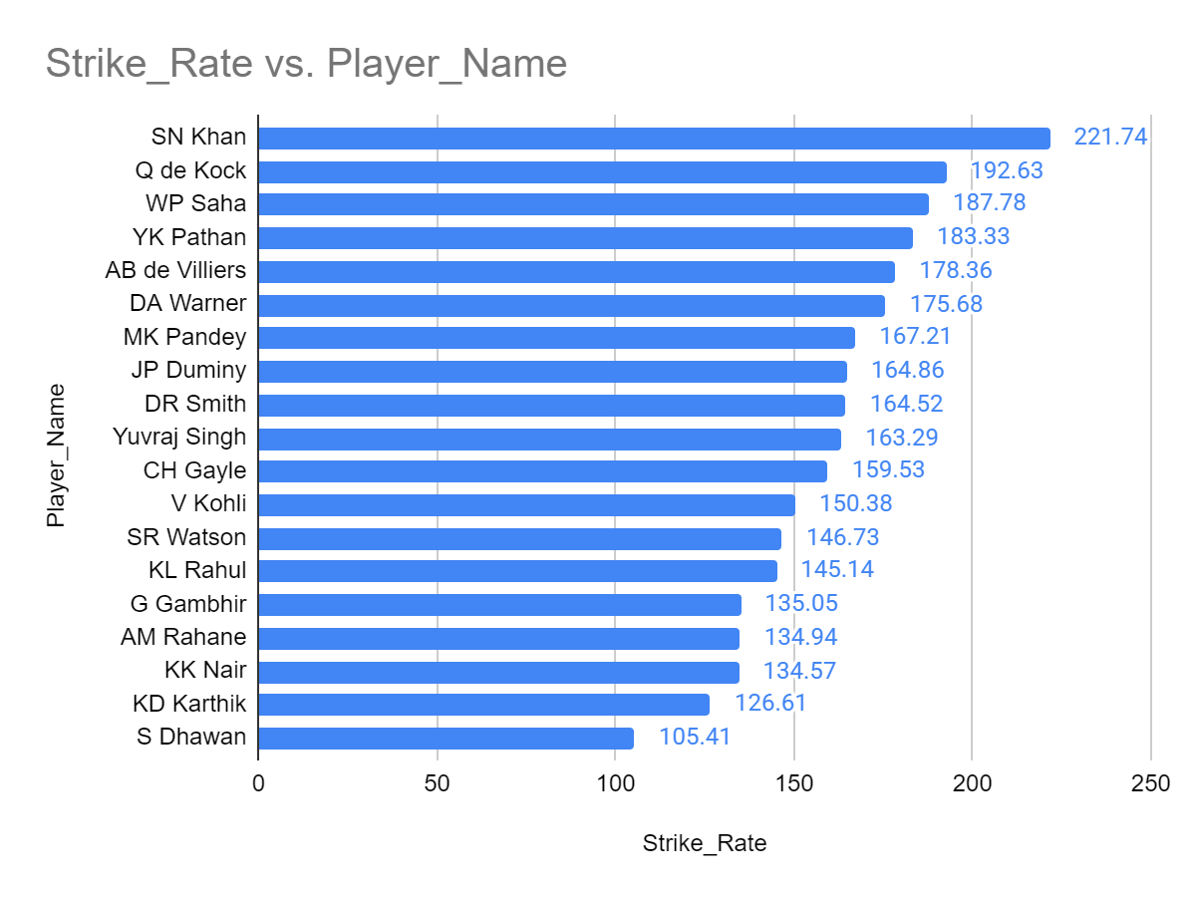
High Strike Rate Players at Chinnaswamy
These are batsmen from all teams, whose performance was good at Chinnaswamy.
We need to focus on them because we could select them in Auction, because Almost 50% of a team’s matches happen in their homeground.

Slide 27
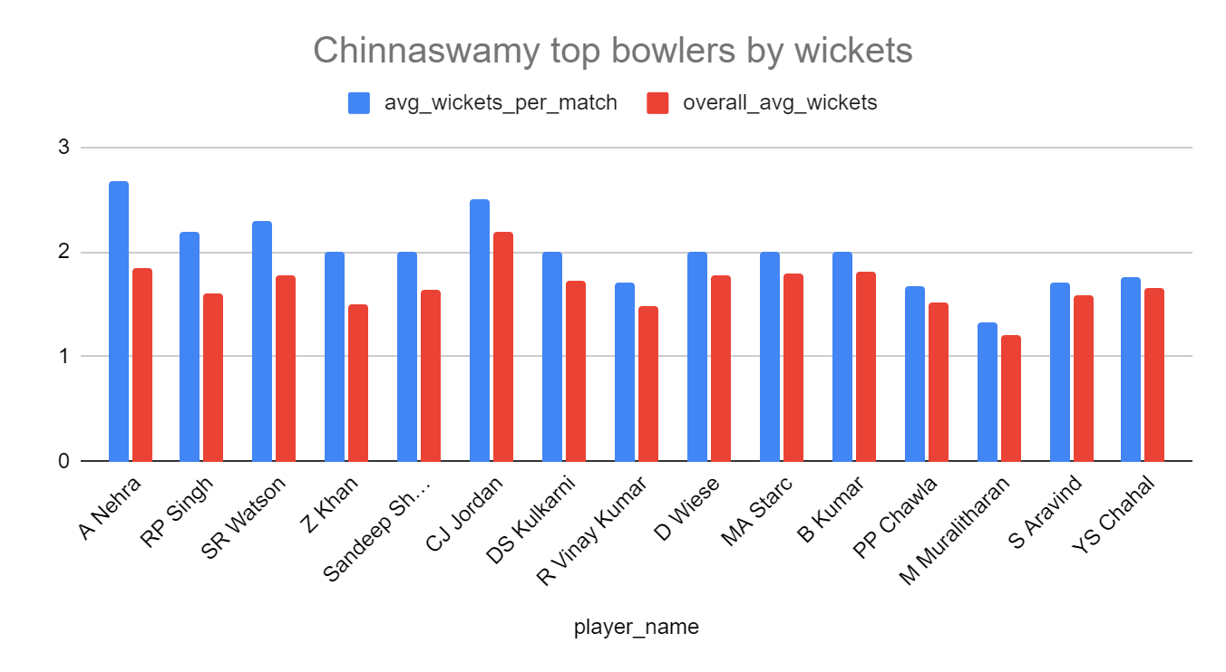
Top Bowlers stats at Chinnaswamy
These are bowlers from all teams whose performance was good at Chinnaswamy.
Players like Ashish Nehra, CJ Jordan, SR Watson, Bhuvneshwar Kumar would be great picks in auction.

Slide 28
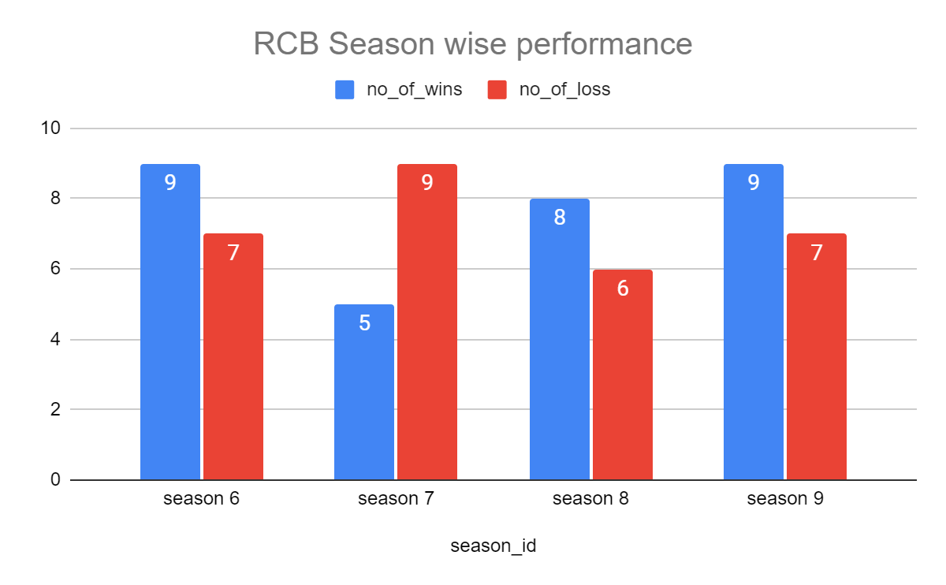
Avg Runs of all seasons
RCB has not won a single trophy during the period 2008 to 2016.
From the last 4 seasons data, we can see that, RCB more than 50% winning matches in seasons 6,8,9.
RCB made it to playoffs in season 8 and 9

Slide 29
Recommended Players

Slide 30
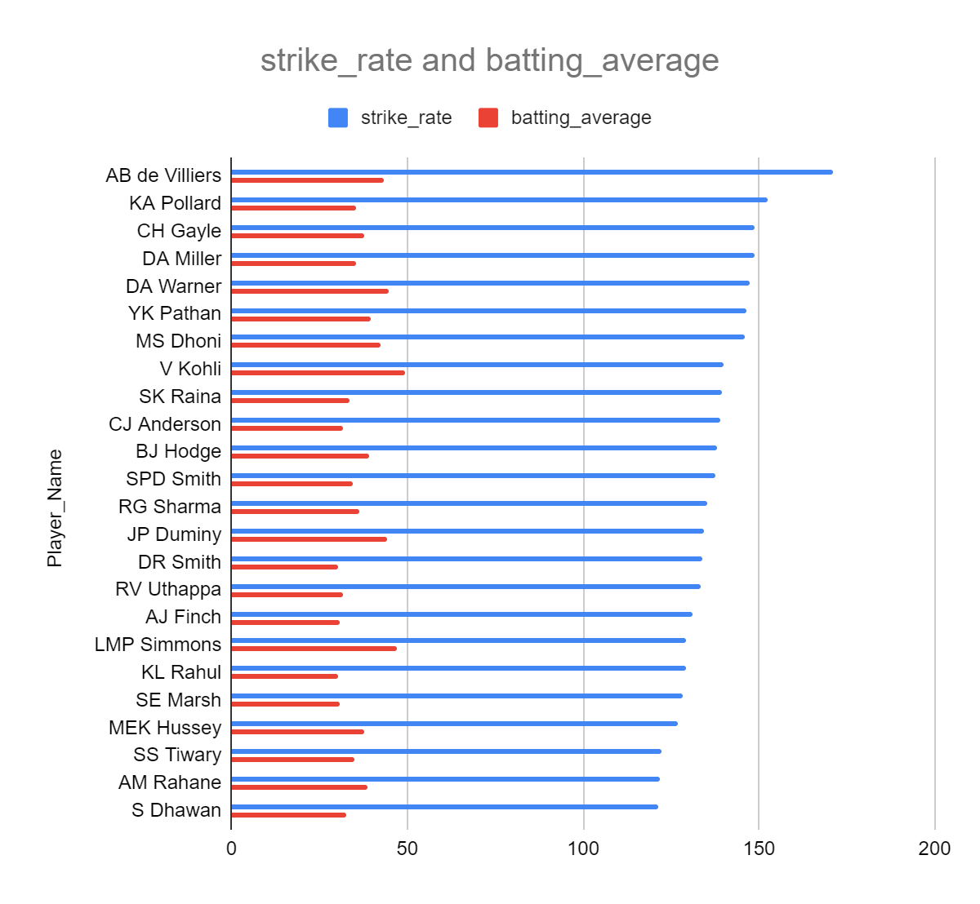
This chart identifies batsmen who are best suited for team selection by combining three critical performance dimensions:
High strike rate
Strong batting average
Sufficient match exposure – ensured by a minimum total runs threshold.
As a result, AB de Villiers, Pollard, CHris Gayle, Virat Kohli, David Warner, Simmons etc can be top choices.

Slide 31
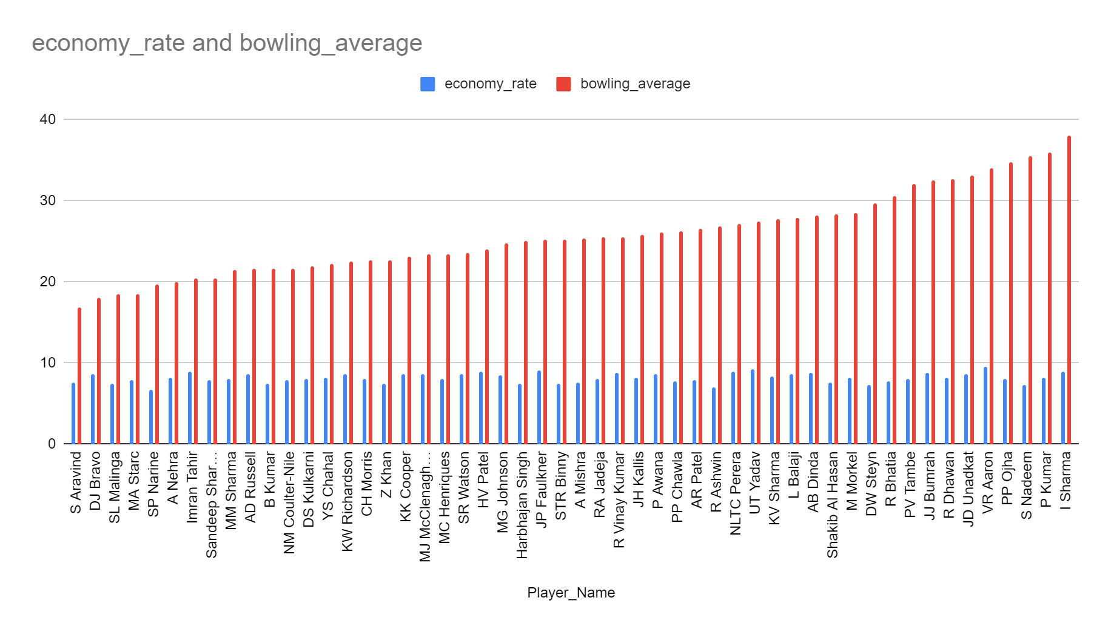
The chart identifies top bowlers whose economy is better and who take wickets within less runs. Aravind, DJ Bravo, Mitchell Starc, Sunil Narine could be top picks.

Slide 32
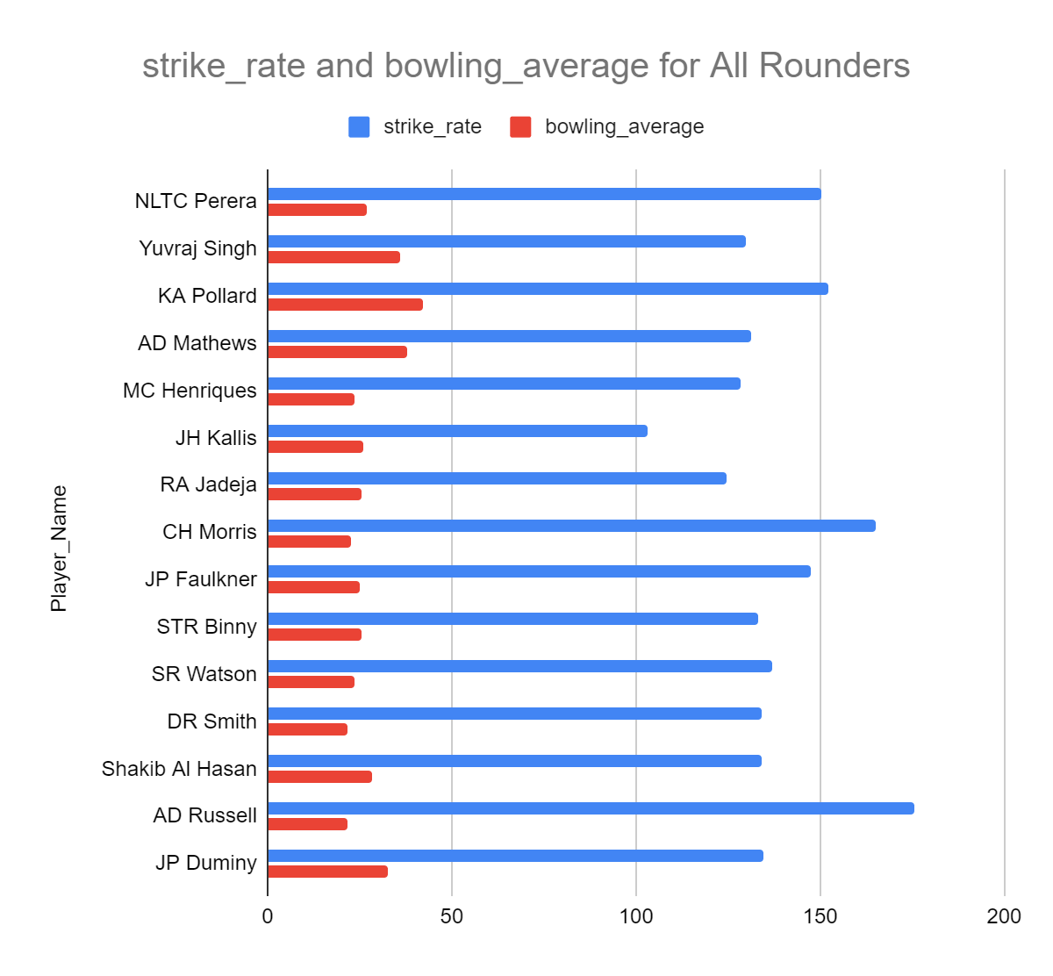
The players in the chart are the ones who appeared commonly in both the top batsmen and top bowler lists.
Having such allrounders helps team when top order fails, especially for team like RCB, where dependency is more on few star players.
Yuvraj Singh, KA Pollard, AD Mathews, CH Morris, AD Russell would be great picks.

Slide 33
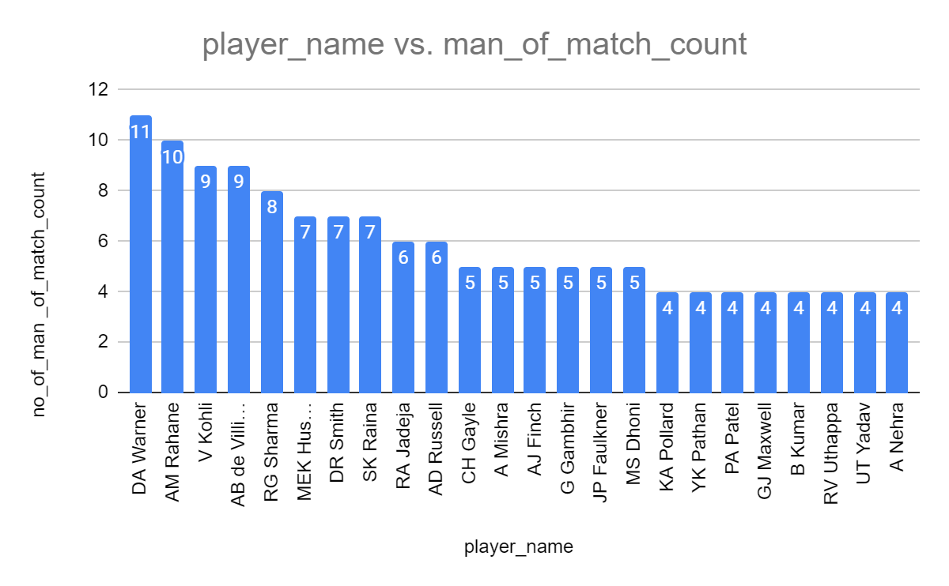
Man_of_match Stats
Usually people capable of getting multiple man of the matches are core players of team, usually retained by the team.
But Mega Auction is coming up and teams may want to reset their team, so RCB needs to look out for such players.

Slide 34
Conclusion
RCB already has a great top order batsman in form of Virat Kohli, Ab de Villiers, Chris Gayle who place high in metrics like total runs, strike rate and batting average & boundary hitting abilities. They help put up good total in the powerplay.
RCB has good bowlers in form of Yuzvendra Chahal, S Watson and Mitchell Starc.
RCB needs all-rounders like Yuvraj Singh, Pollard, Russell and Jadeja to support team when top order batsmen and bowlers fail. Which usually happens in play_offs
RCB is performing above average in almost most of the seasons, it just needs the right balance of roles in team to win play_offs against specific opponents like CSK and MI.

Slide 35


